Slide 1
End-to-End Implementation of a Slimmable Neural Network Atop the Software Stack of the NVDLA
Notes:
Intro

Slide 2
End-to-End Flow
PyTorch Model
Export ONNX
Compile to NVDLA
Runtime Compilation
Network Execution
Notes:
This is the end-to-end flow
You start with defining a PyTorch network class, train it and test it.
Then export to the ONNX format
Next use ONNC to compile the ONNX files into the NVDLA loadable files
Then the runtime needs to be defined - using a version of the SW directory
Finally, the network is executed atop the NVDLA VP platform
[LIVE DEMO]
The final inference takes a reasonably large amount of time, so I will demo the code now and explain each step afterwards. I am going to take a single model: alex_snn_2_part.pth, and show it running atop the NVDLA
The PyTorch model is not relevant to the workflow of the project so will be covered later
First off, we must export to ONNX, the dynamic network is exported into partitions as a dynamic network is currently unsupported by the NVDLA (due to KMD issues)
python3 output_each_partition.py -l
python3 output_each_partition.py alex_snn_2_part
Next we use a docker to access the ONNC compiler, to compile from ONNX to NVDLA
docker run -it -v /home:/home onnc/onnc-community /bin/bash
ls /home/benjamin/Desktop/NVDLA_SlimNNs/Compilation/partitioned_networks/onnx/
tools/onnc/onnc -mquadruple nvdla /home/benjamin/Desktop/NVDLA_SlimNNs/Compilation/partitioned_networks/onnx/alex_snn_2_part_part_1.onnx
This generates the out.nvdla file seen here (do an ls)
I compiled both parts of the network earlier and copied them out of the docker (as this is a long, annoying process)
Next, is to show the compilation of a runtime, using the ubuntu 16.04 docker
docker run -it -v /home:/home ubuntu:16.04
apt-get update
apt-get install gcc-aarch64-linux-gnu g++-aarch64-linux-gnu make -y cd /home/benjamin/Desktop/NVDLA_SlimNNs/Runtime
./compile_and_transfer.sh single_runtime
ls runtime_outputs
Now the final thing to do is to load up the virtual platform and execute the network and the runtimes
First let’s start the docker and copy the relevant files over
docker run -it -v /home:/home onnc/vp
cd /usr/local/nvdla
cp /home/benjamin/Desktop/NVDLA_SlimNNs/Compilation/nvdla_models/alex_2_part_1.nvdla a2p1.nvdla
cp /home/benjamin/Desktop/NVDLA_SlimNNs/Compilation/nvdla_models/alex_2_part_2.nvdla a2p2.nvdla
cp /home/benjamin/Desktop/NVDLA_SlimNNs/Runtime/runtime_outputs/single_runtime single_runtime
cp /home/benjamin/Desktop/NVDLA_SlimNNs/Runtime/used_images/airplane_0.jpg airplane_0.jpg
Next, we need to start the virtual platform itself
aarch64_toplevel -c aarch64_nvdla.lua
mount -t 9p -o trans=virtio r /mnt
cd /mnt
./runtime --parts 2 --loadable a2p1.nvdla --loadable a2p2.nvdla --mean 0.4914,0.4822,0.4465 --normalize 0.2470,0.2435,0.2616 --image airplane_0.jpg --rawdump
Now this will take a while to run, so we will check on the output at the end of the explanation

Slide 3
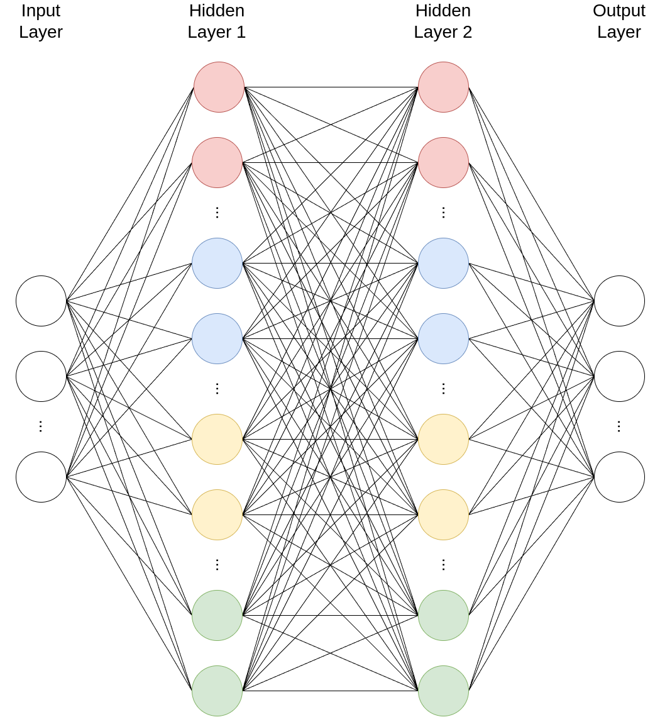
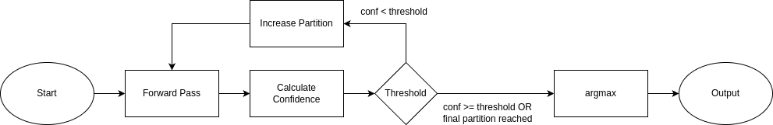
Slimmable Neural Networks
Changes the width of the network:
Convolution: Number of Channels
Linear: Number of Features
Width most commonly defined with a multiplier
Notes:
Slimmable neural networks are a relatively simplistic form of Dynamic Neural Network
The idea is that the network changes its width based on the current stage of the input. Each width that the network operates at is called a partition. For example, one partition would be just green, the next is green and yellow, then green, yellow and blue, etc.
Start with the smallest partition, e.g. ¼ of the original size, and then depending on how confident the network is, it either accepts the output, or it executes again, at a higher width.
The diagram on the right shows a slimmable linear layer, with the colours representing each width it executes at.
The diagram at the bottom shows the flow of the network.

Slide 4
PyTorch Model
New components
Slimmable Linear
Slimmable Convolution
AlexNet-based structure
Two different forward-pass functions
One automatically increases width
One does full process on current width
Incremental training
Train first partition
Then next partition using weights of the first
etc.
Notes:
Two new components have been created, adapted versions of the original PyTorch components - 1 for linear, and one for convolution.
[SHOW CODE]
This shows the slimmable convolutional layer. The main parts of note are the in(out)_channels_list variables as well as the slicing.
The class inherits the features of the original PyTorch nn.Conv2d class, and as such, has the same weight structure as the original. The forward method is overloaded, so that a function performs the actual convolution, rather than a class. This allows it to accept any shape of weights and bias, as long as they correspond with the provided input. This allows the slicing of the original weight structure to be used for a successful computation
The linear component is similar, but rather than channel, it is based on features (just for terminological consistency)
It uses the same logic, of having a width multiplier list, and taking the index of the current multiplier, using that to slice the weight and bias to the correct size and then using the linear computation function to calculate the output.
[BACK TO SLIDE]
The network is based off the AlexNet (originally designed for ImageNet) but adapted for CIFAR10
The main difference apart from the slimmable components is the two forward-pass based model. One of them for testing which automatically increases the width, and one that has no slimmable logic at all.
[SHOW CODE]
Slide showing the two forward methods of the AlexSNN class. The leftone is used for testing, and the right for training. As you can see, there is no confidence calculation on the right hand side, as here you want to train each partition as if it were simply a regular CNN.
Add some bit about definition of the network
[BACK TO SLIDE]
Incremental training is a training method that essentially builds the network from the ground up, each one almost fine-tuning the previous layer. This can be done in two ways, either locking the previous partition’s weights or allowing them to be updated (which is done here). The reason locking weights were not used was mainly for simplicity, as some way of storing separate weights must be used and the goal of the project is the implementation rather than the network itself.
[SHOW CODE]
This is the training loop for the model.
Each width multiplier (partition) is trained (somewhat) independently. A new optimiser with new weight decay is instantiated each time, and the training function is repeated for however many epochs for each partition (here: 10).
[UPDATE ON VP]

Slide 5
Exporting to ONNX
Static version of model created
Original dynamic model loaded
Weights are loaded into correct-sized static model
Use torch.onnx to export (must use opset 8)
Uses the onnx Python module to check the network
Notes:
To export to ONNX there are 5 main steps
Create a static version of the original dynamic network (this is to allow ONNC to compile to the NVDLA loadable)
Load the original dynamic network
Instantiate a new version of the static network for each partition
Load the weights (with the correct size) into each partition
Use the PyTorch ONNX module to export the network
After this the ONNX module can be used with a dummy input to check the execution of the network.
[SHOW CODE]
This is the static version of the AlexSNN that I produced.
It has the exact same structure and each layer is simply the expected size at each layer.
This is a quick slide showing the loading of the weights. The models are kept in a list for simplicity’s sake
This code exports and checks the models
[LIVE DEMO]
First off, we must export to ONNX, the dynamic network is exported into partitions as a dynamic network is currently unsupported by the NVDLA (due to KMD issues)
python3 output_each_partition.py -l
python3 output_each_partition.py alex_snn_2_part

Slide 6
Compiling to NVDLA
Use the ONNC compiler
Best done on the onnc/onnc-community docker
The below syntax produces the NVDLA loadable in the current working directory as “out.nvdla”
docker run -it -v /home:/home onnc/onnc-community tools/onnc/onnc -mquadruple nvdla <path_to_model>/model.onnx
Notes:
Compiling to NVDLA is done with the ONNC compiler. This is an open-source compiler design to export from ONNX to any deep learning accelerator.
Dockers are great. Seriously brilliant. Compiling with onnc can be done really quickly and easily with the ONNC community docker. Takes literally two commands (+ some more for transferring the model)
You can see an example compilation below, with the resulting file.
[LIVE DEMO]
Next we use a docker to access the ONNC compiler, to compile from ONNX to NVDLA
docker run -it -v /home:/home onnc/onnc-community /bin/bash
ls /home/benjamin/Desktop/NVDLA_SlimNNs/Compilation/partitioned_networks/onnx/
tools/onnc/onnc -mquadruple nvdla /home/benjamin/Desktop/NVDLA_SlimNNs/Compilation/partitioned_networks/onnx/alex_snn_2_part_part_1.onnx
This generates the out.nvdla file seen here (do an ls)
I compiled both parts of the network earlier and copied them out of the docker (as this is a long, annoying process)

Slide 7
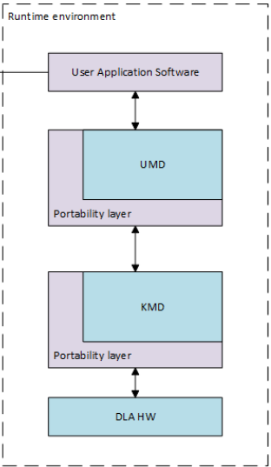
NVDLA Runtimes
Two types:
Single-UMD
Multi-UMD
Minor changes to normalisation
Some changes to data structures for Single-UMD runtime
Uses edited form of the NVDLA SW repository (same Makefile, different files)
Notes:
So within the NVDLA stack, there are three software layers, and the hardware layer. The UMD stands for User Mode Driver, and provides a standard API for interfacing with the hardware.
The kernel mode drive (or KMD) is what schedules time, allocates memory, etc.
I’ve developed two runtimes: a single-UMD runtime and a multi-UMD runtime. Alongside these, I’ve made some minor modifications, most notably to normalisation, allowing for multiple standard deviation normalisation values to be passed to the runtime, rather than just one, giving more accurate normalisation. Both new runtimes were created and now sit within an edited version of the NVDLA SW repository - available on my GitHub.

Slide 8
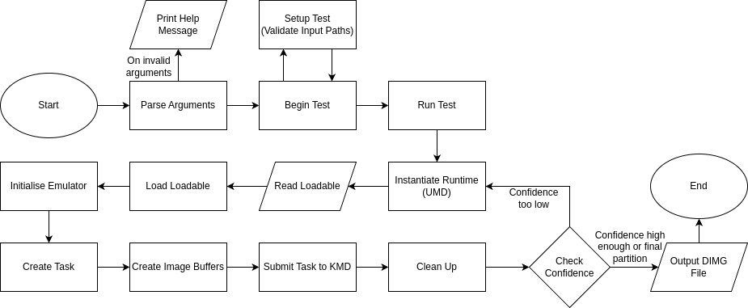
Runtime - Single-UMD
Red boxes are where the UMD interacts with the KMD
Notes:
On the slide is the flow chart of the single-UMD runtime. It may look like a lot, but it is more normal than it seems. The flow essentially starts with your usual parsing of arguments.
Begin test and run test are mainly validation checks and the main wrapper function for the program respectively
Instantiating the runtime is the creation of the UMD object.
Following that, the program reads and loads the loadables
The initialisation and creation of the emulator and task setup the environment for the inference
The creation of the image buffers are essentially the allocation of the memory for the images
The inference actually happens when the task is submitted, and then outputs are calculated.
After this, the program cleans up the memory
At this point, the confidence in the output is checked, before either outputting the final dimg file, or starting the program again at the runtime instantiation
The boxes highlighted in red are those where the UMD interacts with the KMD.
[SHOW CODE]

Slide 9
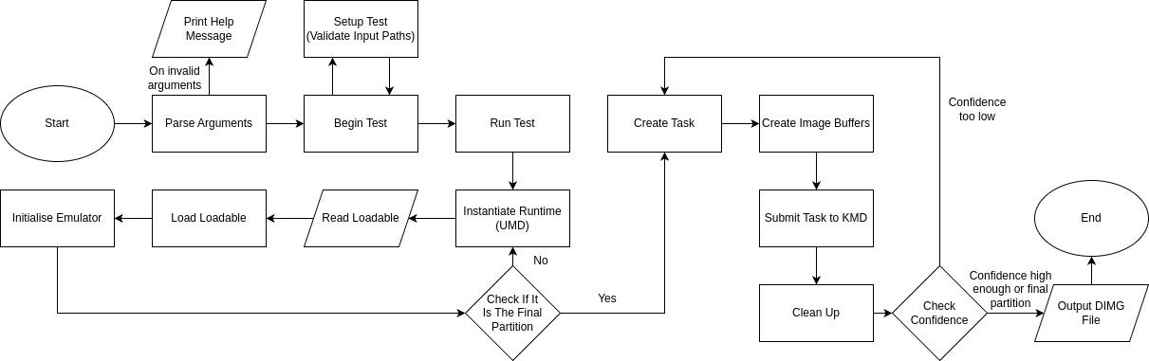
Runtime - Multi-UMD
Red boxes are where the UMD interacts with the KMD
Notes:
This is the flow chart for the multi-UMD system.
Rather than loading each loadable based on when it is needed, this runtime loads them all at the start.
By front-loading all of the loadables (with a second loop) it creates an environment that would be more efficient for a series of inferences on many images.
[SHOW CODE]

Slide 10
Runtime Compilation
Most easily done in a docker:
docker run -it -v /home:/home ubuntu:16.04 apt-get update apt-get install gcc-aarch64-linux-gnu g++-aarch64-linux-gnu make
aarch64 Linux toolchain is important
Uses the regular Makefile in the SW repository, only with different files:
Within the sw/umd directory, run:
make TOOLCHAIN_PREFIX=aarch64-linux-gnu- ROOT=$(pwd)
A lot more detail is available on my GitHub
Notes:
Compilation of the runtime is relatively simple, and uses another docker (a standard ubuntu one)
To successfully compile, 3 packages have to be installed
After this, the regular Makefile is used as can be seen on the slide
A script was written to compile and then transfer somewhere for the sake of ease
[LIVE DEMO]
I’ve already loaded the docker and installed the required packages
Next, is to show the compilation of a runtime, using the ubuntu 16.04 docker
docker run -it -v /home:/home ubuntu:16.04
apt-get update
apt-get install gcc-aarch64-linux-gnu g++-aarch64-linux-gnu make -y cd /home/benjamin/Desktop/NVDLA_SlimNNs/Runtime
./compile_and_transfer.sh single_runtime
ls runtime_outputs

Slide 11
Virtual Platform
Essentially the NVDLA emulator
Difficult to compile - use the docker
Original NVDLA VP: nvdla/vp
ONNC NVDLA VP: onnc/vp
Login:
Username: root
Password: nvdla
Mount the drive: mount -t 9p -o trans=virtio r /mnt
Initialise the environment: ./init_dla.sh
Notes:
The NVDLA virtual platform is pretty much just the emulator for the NVDLA
Again, another docker is used, and two are available
The ONNC virtual platform has expanded on the original, and has more support in recent times
After loading into the docker, navigate to the nvdla directory and run the command seen there
The login for the virtual platform is the same for both forms by default: root and nvdla
After starting the virtual platform, the drive has to be mounted (see command) and the environment initialised, importing the required libraries into the VP

Slide 12

Executing Runtime
Generates a dimg file: output.dimg
rawdump argument makes this human readable
Execution takes a long time, but will get to a result
Normalisation not mandatory, but needed if the network was trained on normalised images
Number of loadables must match the number of parts
Notes:
After running the VP, the runtime can be executed. The two runtimes I created have the same arguments for the program.
It is a very long command, with the mean and normalize arguments specified for the CIFAR10 dataset.
The number of partitions has to be specified and the loadables listed
The runtime outputs a dimg file, containing the direct output of the network
It’s important to note that the execution takes a while due to the nature of the emulator being reasonably inefficient.
[LIVE DEMO]
Now the final thing to do is to load up the virtual platform and execute the network and the runtimes
First let’s start the docker and copy the relevant files over
docker run -it -v /home:/home onnc/vp
cd /usr/local/nvdla
cp /home/benjamin/Desktop/NVDLA_SlimNNs/Compilation/nvdla_models/alex_2_part_1.nvdla a2p1.nvdla
cp /home/benjamin/Desktop/NVDLA_SlimNNs/Compilation/nvdla_models/alex_2_part_2.nvdla a2p2.nvdla
cp /home/benjamin/Desktop/NVDLA_SlimNNs/Runtime/runtime_outputs/single_runtime single_runtime
cp /home/benjamin/Desktop/NVDLA_SlimNNs/Runtime/used_images/airplane_0.jpg airplane_0.jpg
Next, we need to start the virtual platform itself
aarch64_toplevel -c aarch64_nvdla.lua
mount -t 9p -o trans=virtio r /mnt
cd /mnt
./runtime --parts 2 --loadable a2p1.nvdla --loadable a2p2.nvdla --mean 0.4914,0.4822,0.4465 --normalize 0.2470,0.2435,0.2616 --image airplane_0.jpg --rawdump
Now this will take a while to run, so we will check on the output at the end of the explanation

Slide 13
Thank You For Listening
https://github.com/TroubledBagels/NVDLA_SlimNNs

